Slide 1

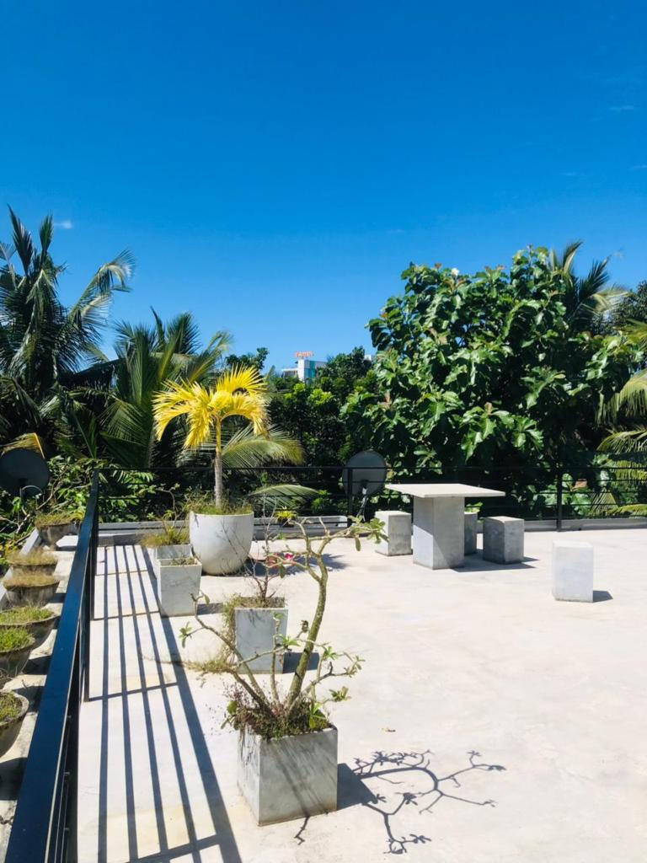
hotel and restaurant
Villa happy hours
Room Reservation System
Group M

Slide 2
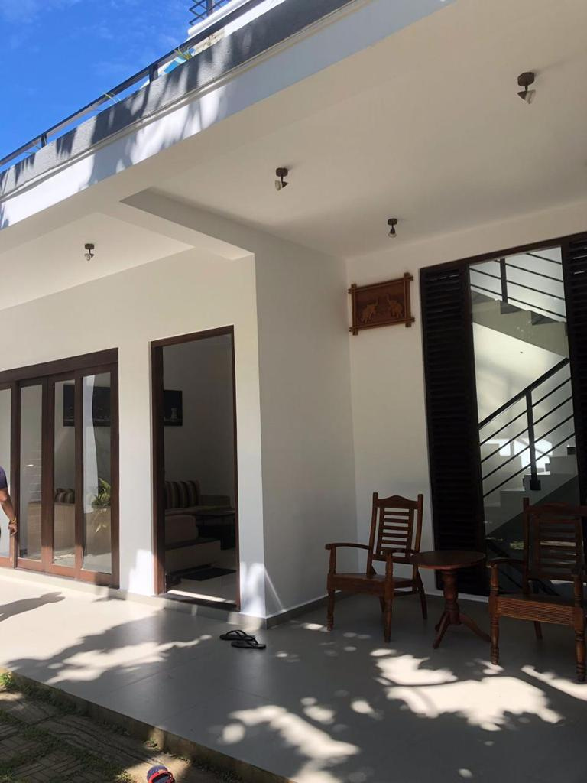
VILLA HAPPY HOURS
MISSION
"Our mission is to exceed our customer's expectations by providing genuine hospitality,
a valued experience, and a commitment to continuous improvement"

Slide 3
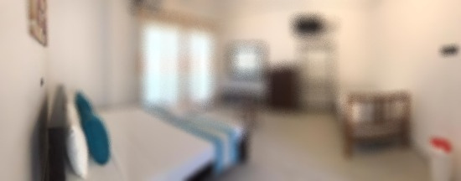
Agenda
3 | Introduction & Selected BP
4 | As Is Process Model
5 | Data gathered methods
6 | Identify Weakness
7 | Qualitative Analysis (As Is Process)
8 | Suggested Improvement
9 | To Be Process
10 | Qualitative Analysis (To be Process)
11 | Process redesign & Conclusion

Slide 4
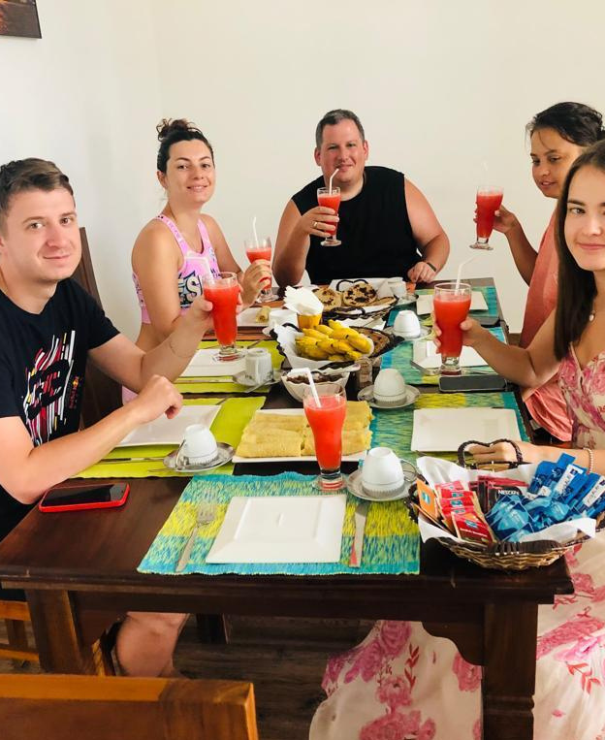
Introduction & selected BP
About organization
Villa happy hours is a mid-level hotel and restaurant located in the Anuradhapura area.
They currently facilitate as a hotel and restaurant by providing room facility, Cafeteria, and food service
Why we selected the Room Reservation process:
Importance
Dysfunction
Feasibility

Slide 5
Data gathered methods
Document Analysis
Observations
Interview
Questioner

Slide 6
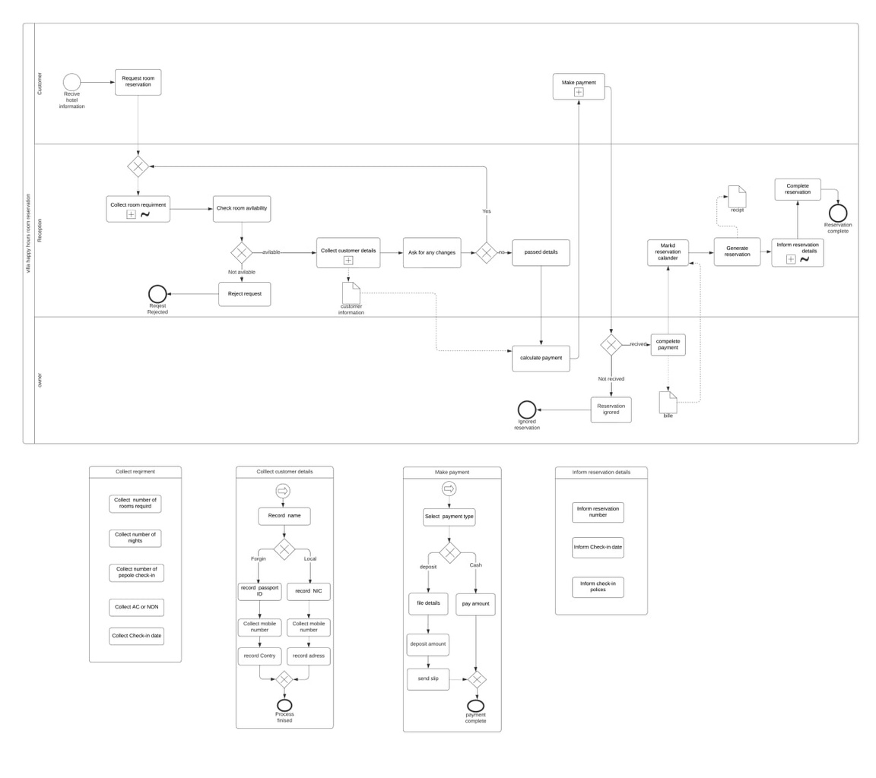
AS IS MODEL
Current situation of booking a room.
When Starts a given process instance?
When do we consider a process completed or Ended?
What are the key Objects in the process?
Whom are the Actors/participations performing?
Who is the Owner of this process?

Slide 7




ISSUES OF THE PROCESS
TIME
COST
QUALITY
Claim much Check Room Availability takes time.
Mark the booking calendar clams time.
Transfer details between reception and owner
Request acceptance.
Employee maintenance cost.
documentations maintenance cost.
Missed reservations – changing reservation numbers between customers

Slide 8
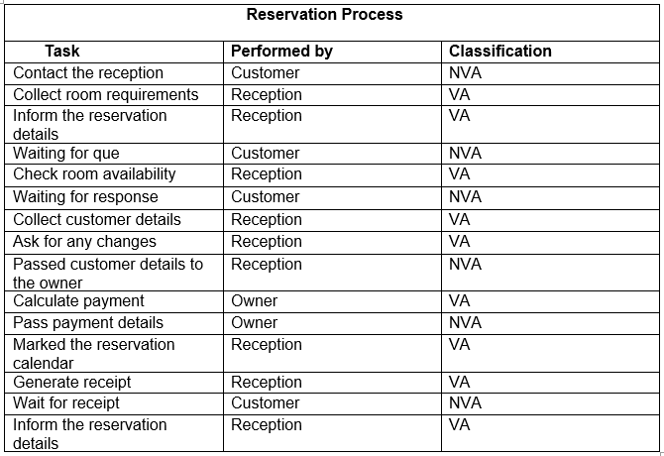
Qualitative analysis (As is Process model)
Qualitative analysis of business process identifies value-adding and non-value-adding activities.
Value-adding activities are essential for successful business processes.
Eliminating non-value-adding activities to optimize business processes.
This is crucial as the waiting time is high and needs improvement.

Slide 9

SUGESSTED IMPROVRMENT
Time | Web-based software solution to automate the business process, perform faster
Cost | suggest an electronic database to collect the details and send an email receipt to the customers
Quality | Eliminates human errors and missed places by making the system automated.
WE SUGGEST A NEW WEB-BASED ONLINE ROOM RESERVATION SYSTEM FOR THE VILLA HAPPY HOURS
HOTEL & RESTURANT. THIS WEB BASE SOLUTION WILL INCREASE THE PERFORMANCE OF BUSINESS PROCESSES TO OVERCOME THE ISSUES
USER-FRIENDLY INTERFACES
Support for multiple devices
Reduce administrative workloads through online transactions
IMPROVE OVERALL WORKLOAD PRODUCTIVITY
multiple device access
Improve employee productivity & time management
Information base with chat, ads, offers & videos to attract more customers
24/7 availability for customers to book anytime, anywhere
Feedback identifies areas for improvement
Notes:
We suggest a new web based online room reservation system for the villa happy hours hotel to facilitate their services to the customers This web-based solution will increase the performance of business process to over come the issues and also this system allow customers to make self reservation and make online payments. And it is going to be operated as a part of the booking website where customers can find calendar , online booking in real time, online payment method, generate automated mail system , cancelling rescheduling and other relevant option. Through out this website they can save time, cost & resources effectively And also, they can improve their product quality .Furthermore these are the other improvements of this website.

Slide 10


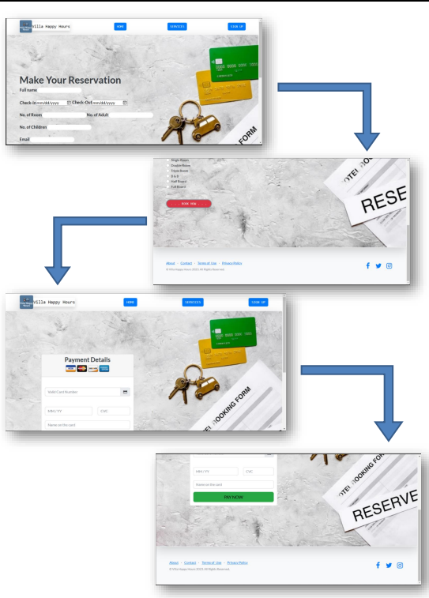
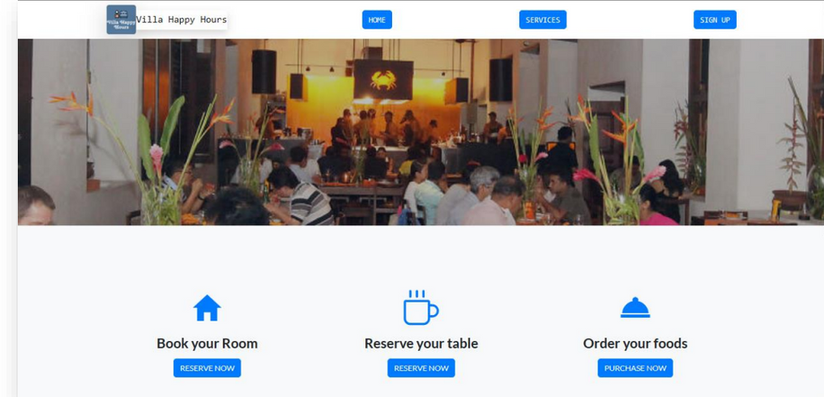

online reservation system

Slide 11
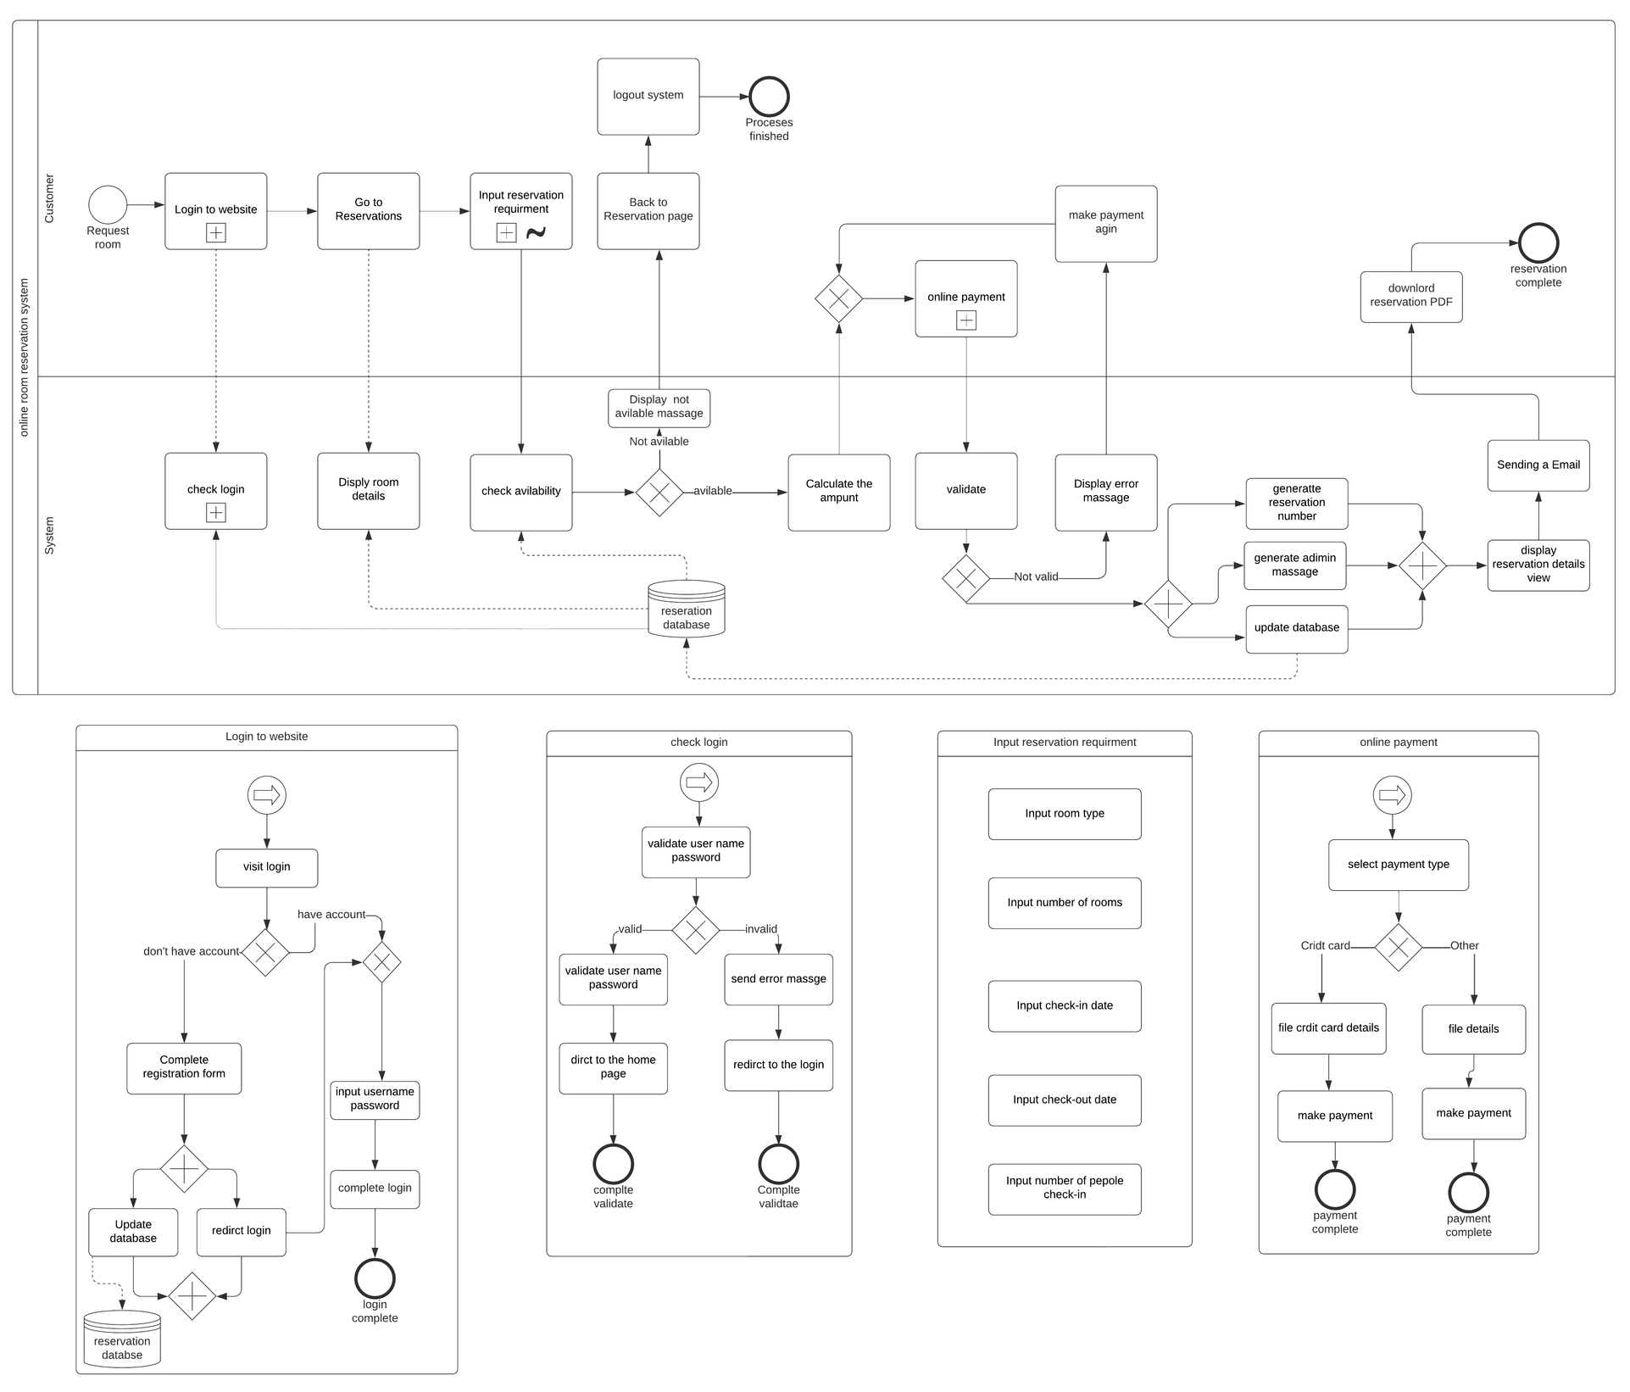
TO BE PROCESS MODEL
Changed the business process activities and actors by introducing a new room reservation process with the system
The customer directly connects with the system to make their reservation without any interaction with other actors
The process flow will be changed and simplified than the AS-IS model
the process will be automated

Slide 12
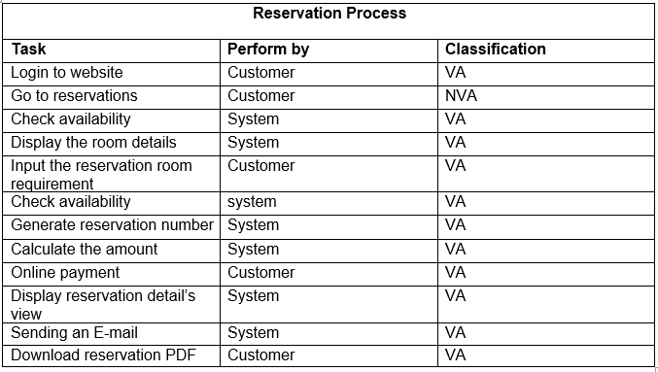

QUALITATIVE ANALYSIS (TO BE PROCESS MODEL)
Eliminating non-value-adding activities in the to-be process model.
An online reservation system reduces non-value-adding activities.
To-be process model aims to improve value-adding activities and business process quality.
·Lean business process approach optimizes business process to reduce waste.

Slide 13



Process redesign
CONCLUSION
Goal- improve the processes from beginning to end.
Changing business process operation.
Changing the order of activities.
Changing the actors of the process.
Changing the technologies.
The manual process consumes lots of pure west
The suggested solution will increase business process performance by decreasing pure waste.

Slide 14
Group M
Student name | Student ID
R.G.I.S.Senarathna | 22742
B.D.D.Wijegunawardhana | 22712
S.K.H.I.M.Herath | 22688
K.H.M.S.Dilshani | 22746
L.T.D.S.Sandupama | 23892

Slide 15
THANK YOU
Q&A TIME

